Slide 1
Check Your Work CS 7346 Cloud Computing
Group 6 Members: Bingying Liang, Hanyun Wei, Lei Ke
July 19, 2023

Slide 2


Check your work ?

Slide 3

Introduction of Check Your Work
A university has greatly expanded its CS course and wants to be able to automate the grading of simple programming assignments.
Requirements:
Grading automatically, persistent and auditable.
A plagiarism detection
University’s learning management system (LMS).

Slide 4
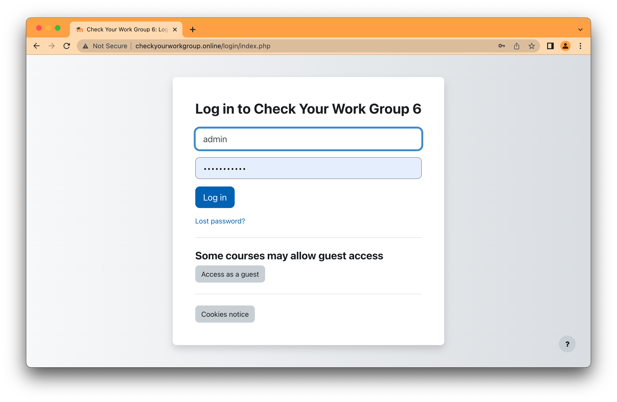
Solution-LMS

Slide 5
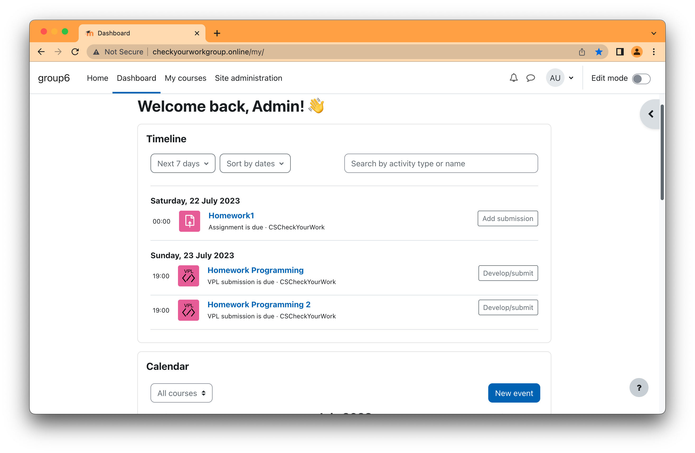
Solution-Roles

Slide 6
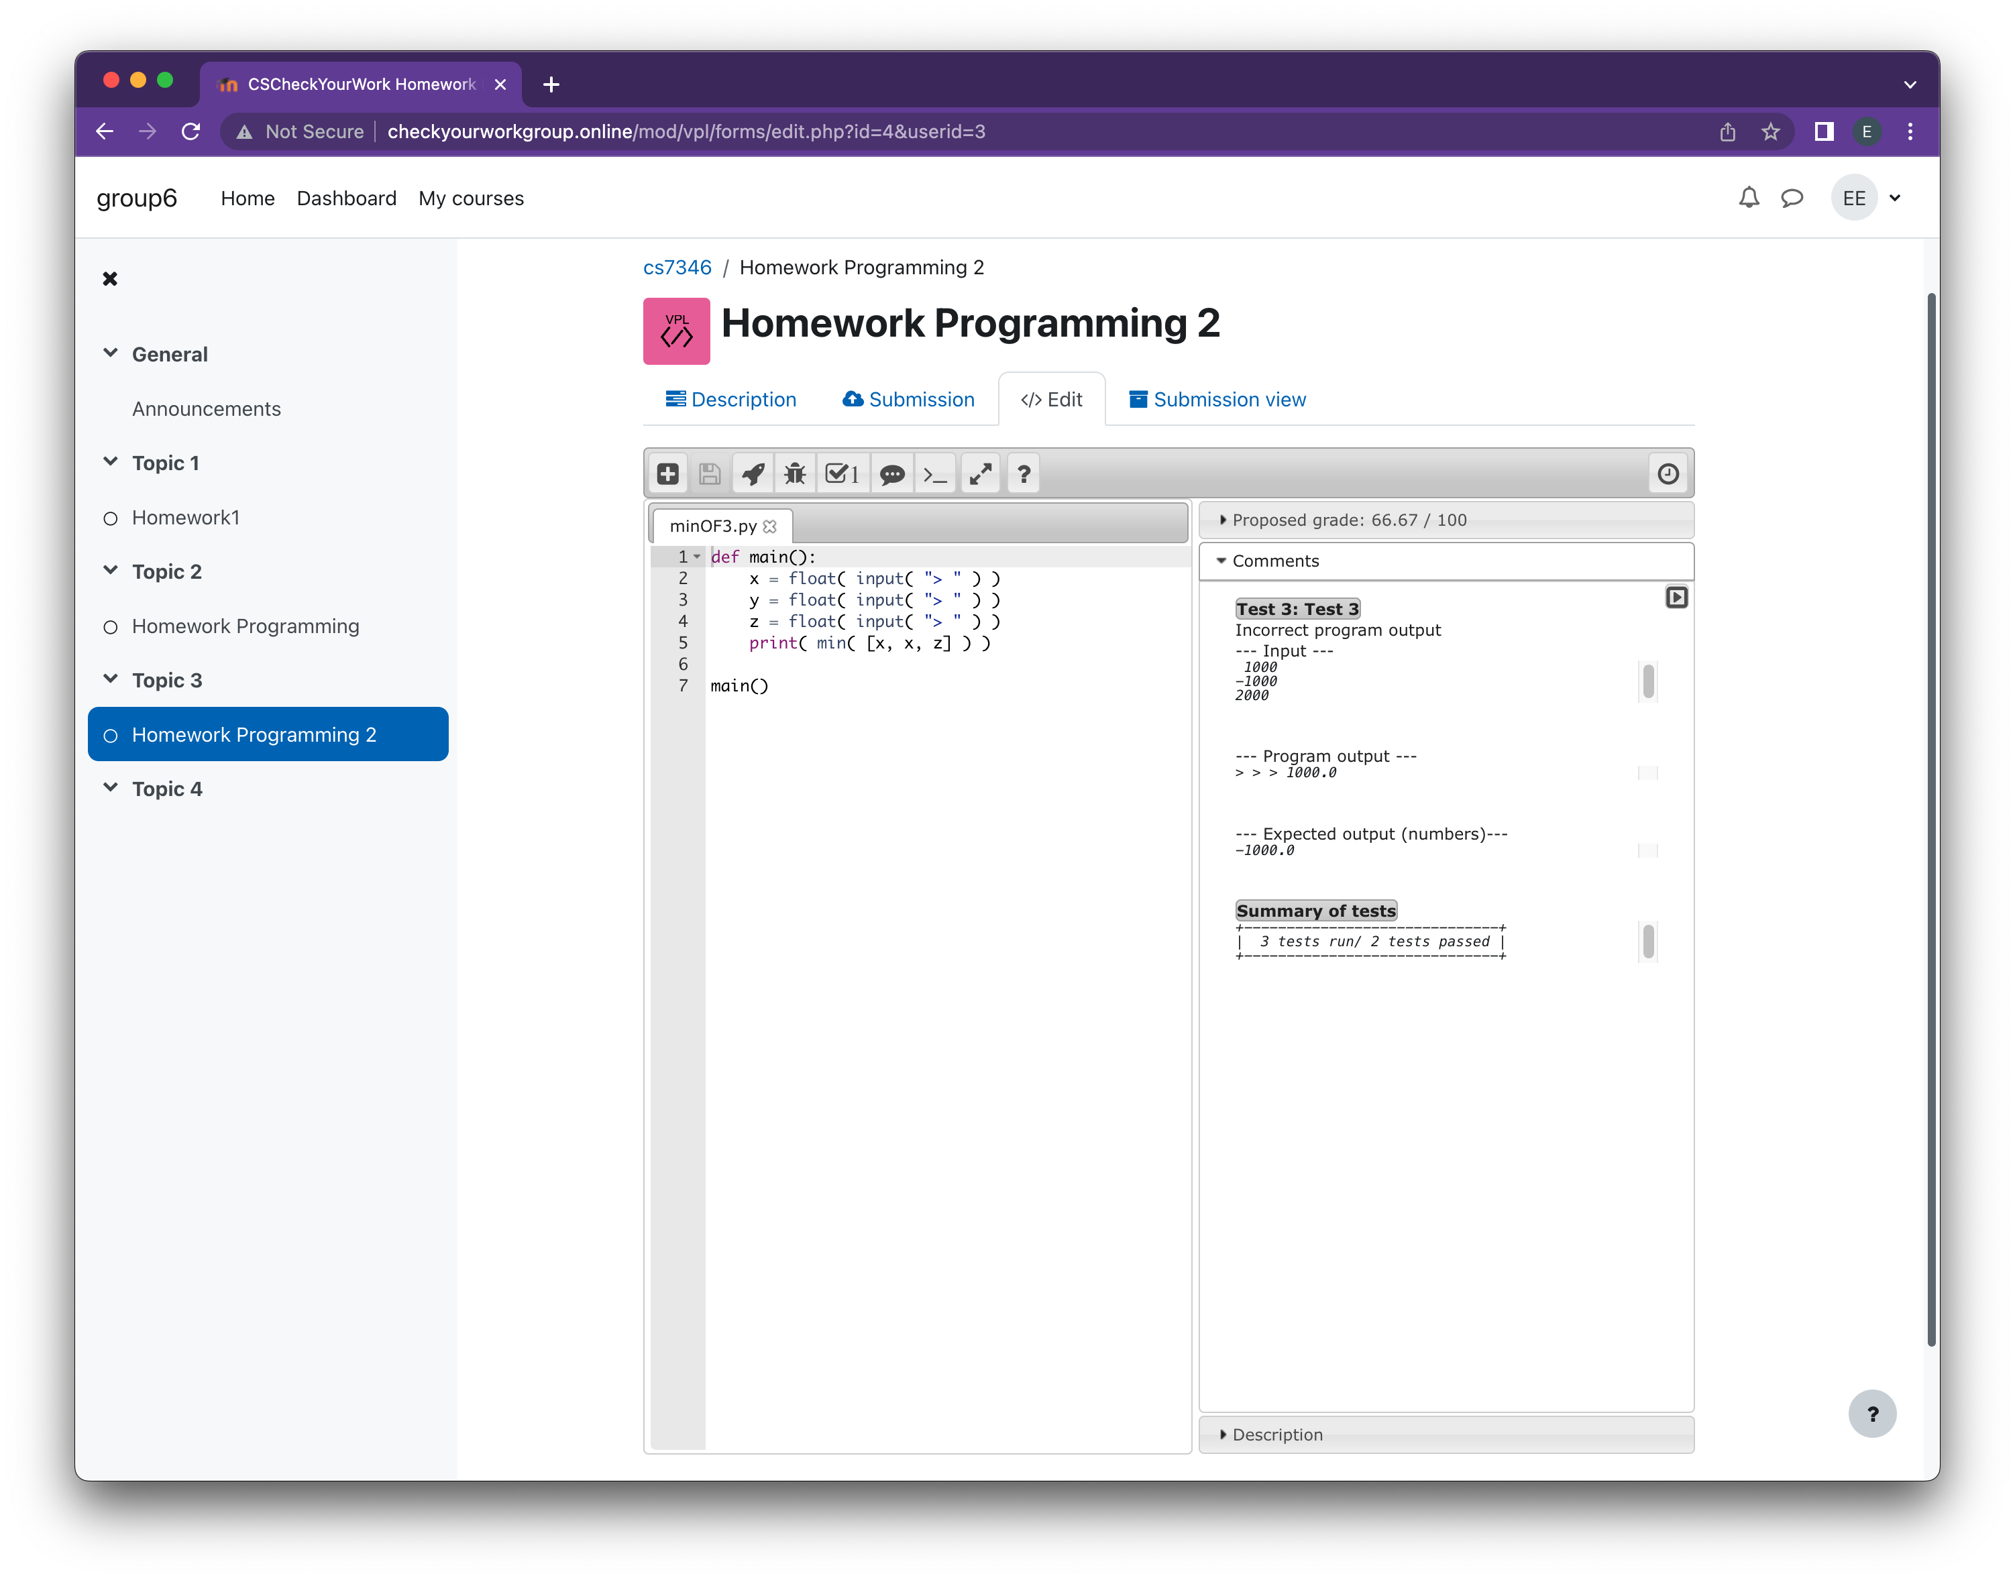
Solution-Auto Grade

Slide 7
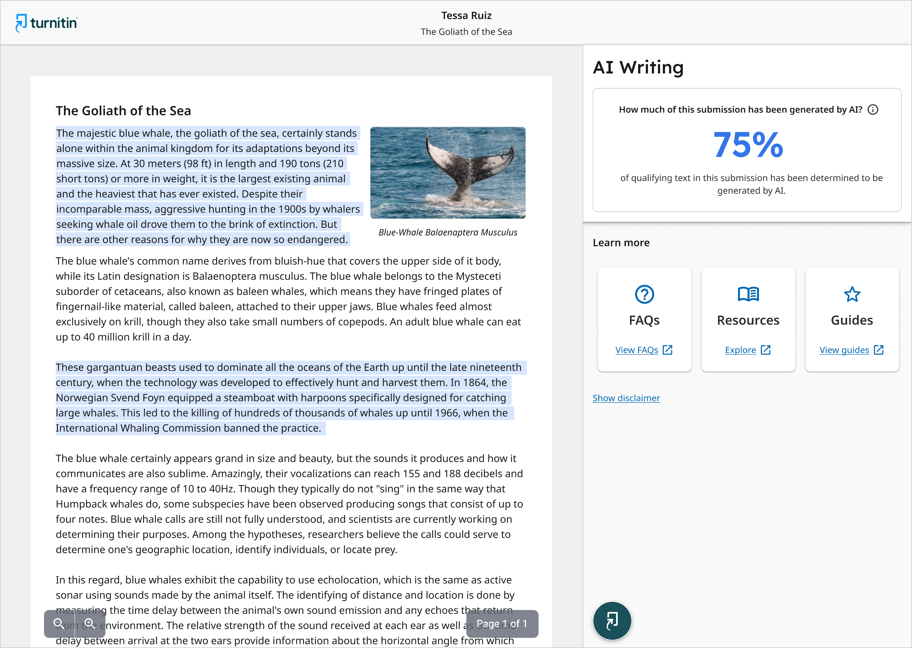
Solution-Plagiarism

Slide 8
Cloud-based Architecture

Slide 9
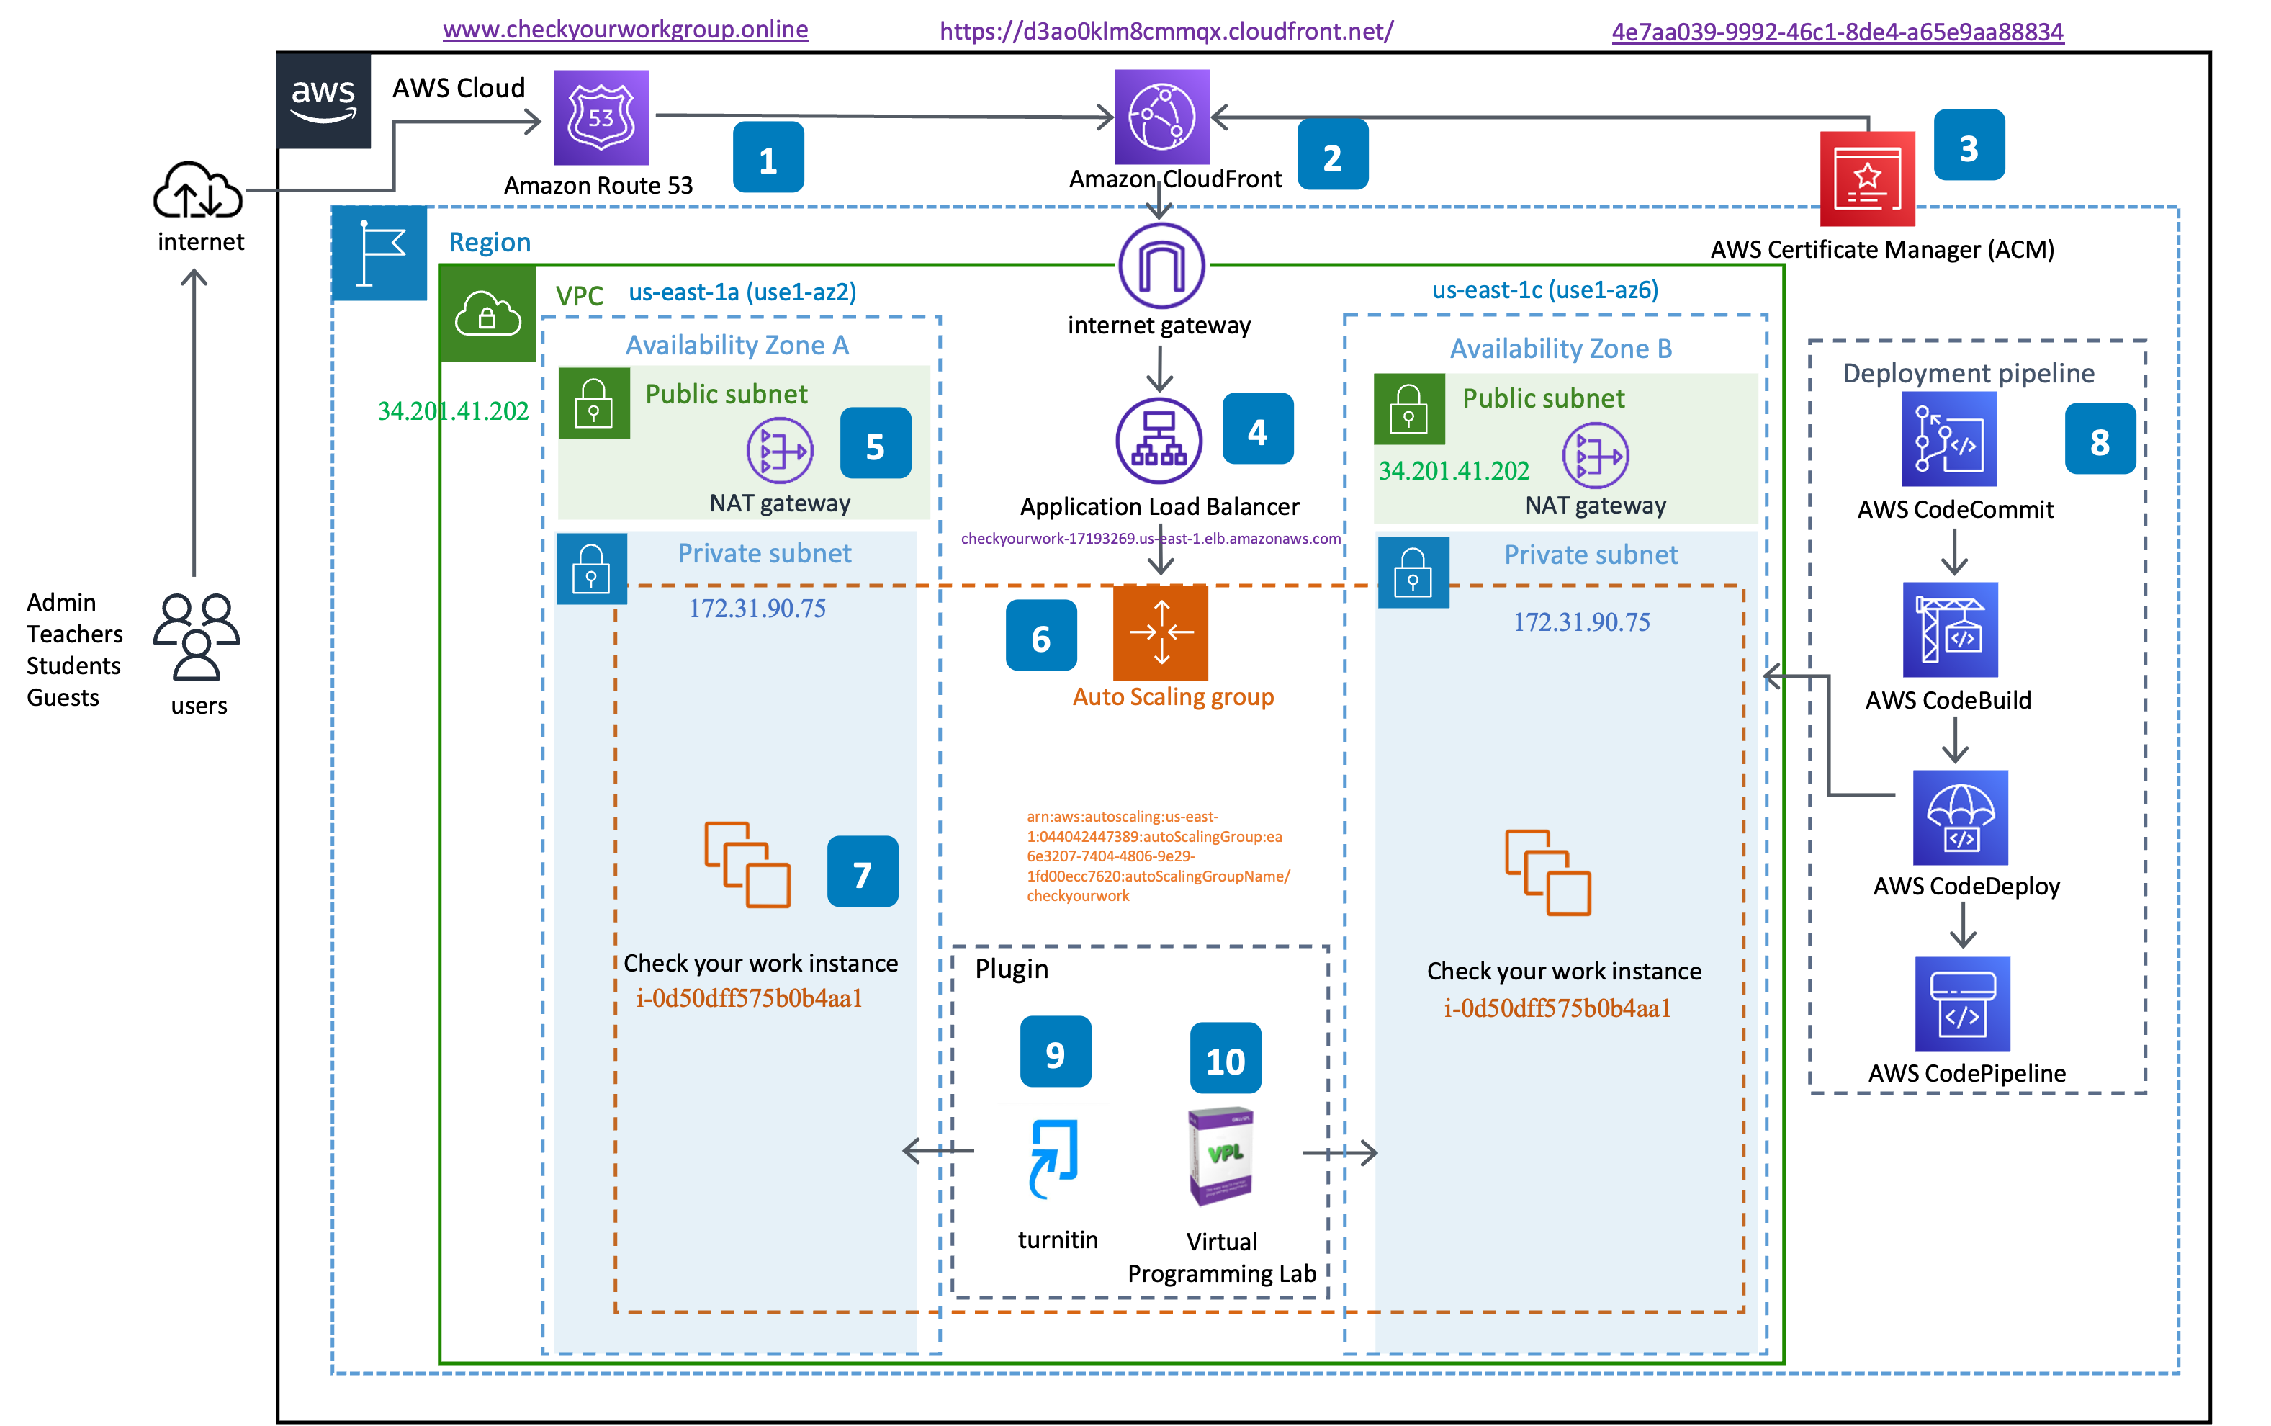
Cloud-based Architecture

Slide 10
Priorities
√ Security √ Performance
√ Availability √ Usability

Slide 11

. Advantages
Cost-effective
Security
Low Latency

Slide 12

Limitations
Navigating service is complex
Risks
Downtime Risk
Performance Risk
Privacy Risk
Lock-in Risk

Slide 13
Demo

Slide 14
DEMO
http://www.checkyourworkgroup.online

Slide 15
Contributions

Slide 16

Contributions
A feasible cloud architecture is proposed and implemented
Offered steps toward a better understanding of AWS projects
Given other developers as an example

Slide 17
Thank you for listening

